Slide 2
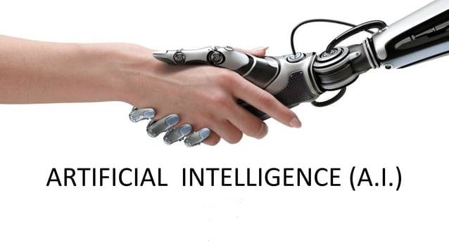
-Presented by Department of CSE Subject: English Subject: Eng-102 Batch : 29th

Slide 3
Students name and ID
Name | ID
Abdul al momin | 203031001
Jannatul nayeem | 223031002
Fatema sultana | 223031003
Suraiya binte kamal | 223031004
Mohammed akbar hossen | 223031005
Meftahul jannat | 223031006

Slide 4
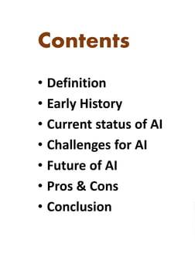
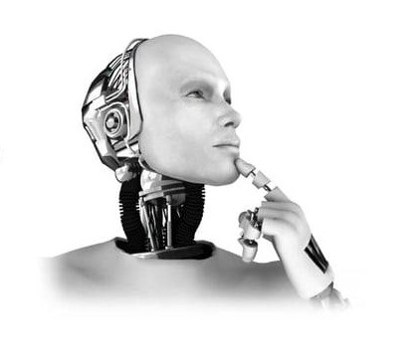

Slide 5
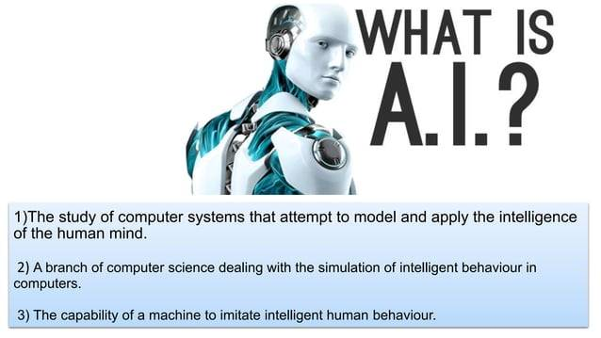

Slide 6
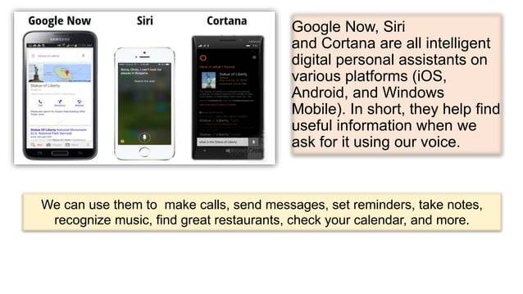

Slide 7
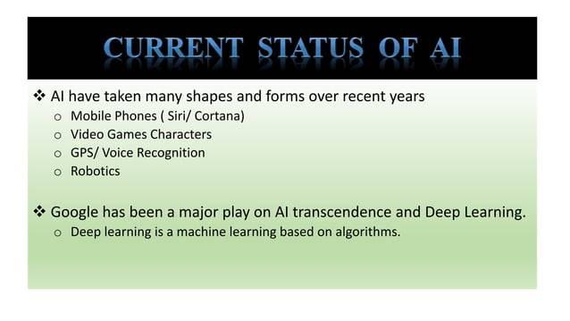

Slide 8


Slide 9
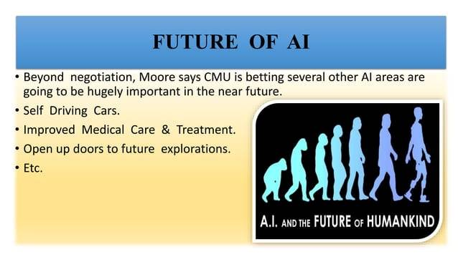

Slide 10

Pros of Artificial Intelligence: | Cons of Artificial Intelligence:
Automation and Efficiency Improved Decision Making Enhanced Accuracy Advanced Problem Solving Innovation and Advancements | Job Displacement Unethical Considerations Lack of Human Judgment and Intuition Reliance on Data and Algorithms Security and Privacy Risks

Slide 11
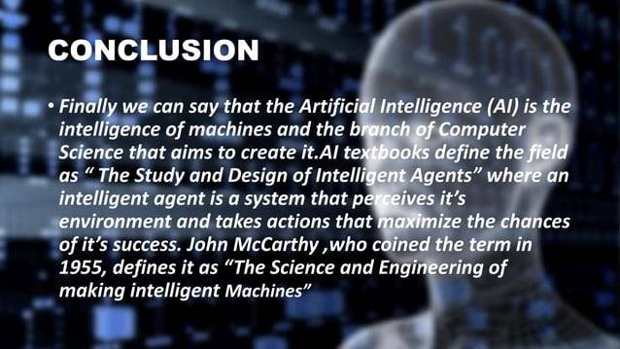

Slide 12
Thank you

